Slide 1
Modeling the effect of radiation therapy as direct versus indirect effects on tumor volume
Achyudhan Kutuva
11/05/2021

Slide 2




Slide 3
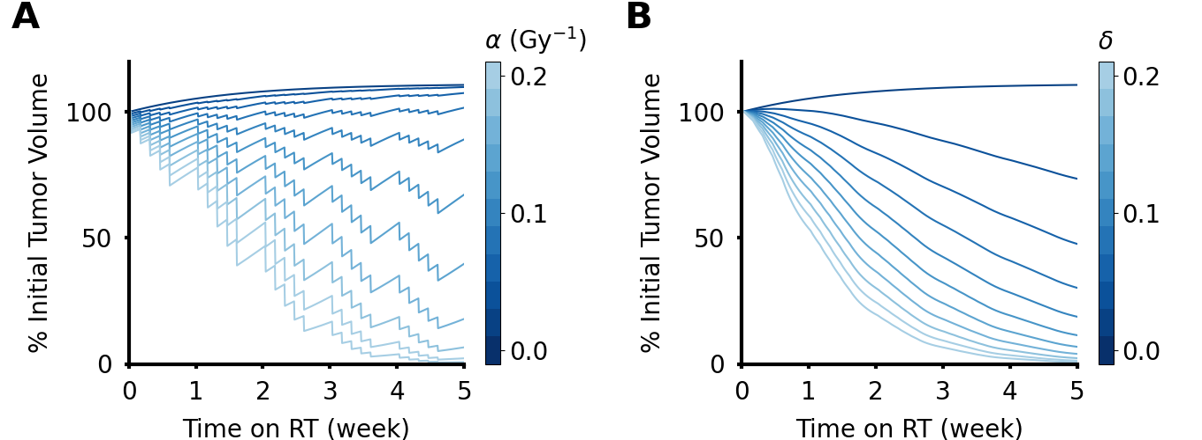

Slide 4
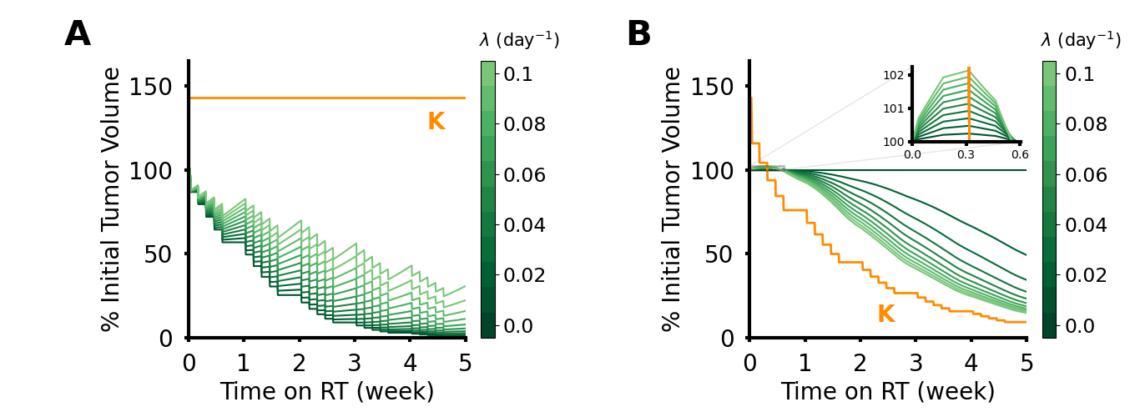

Slide 5
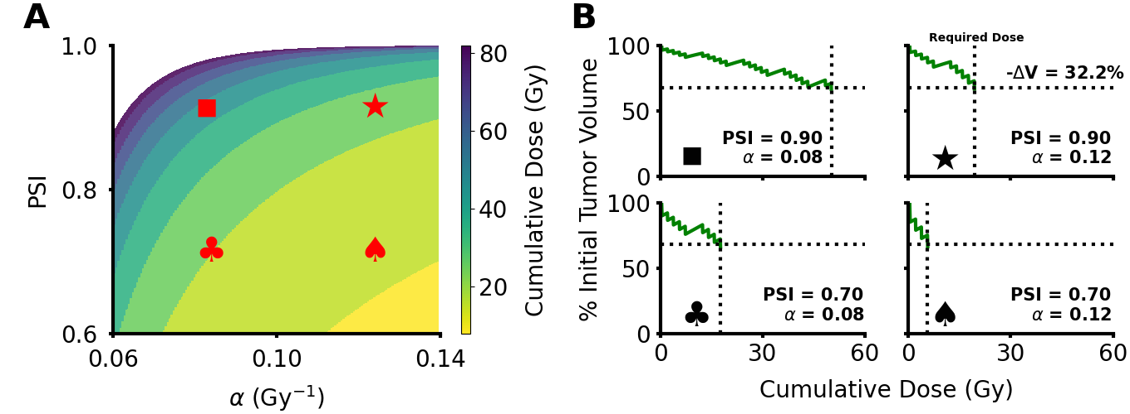

Slide 6
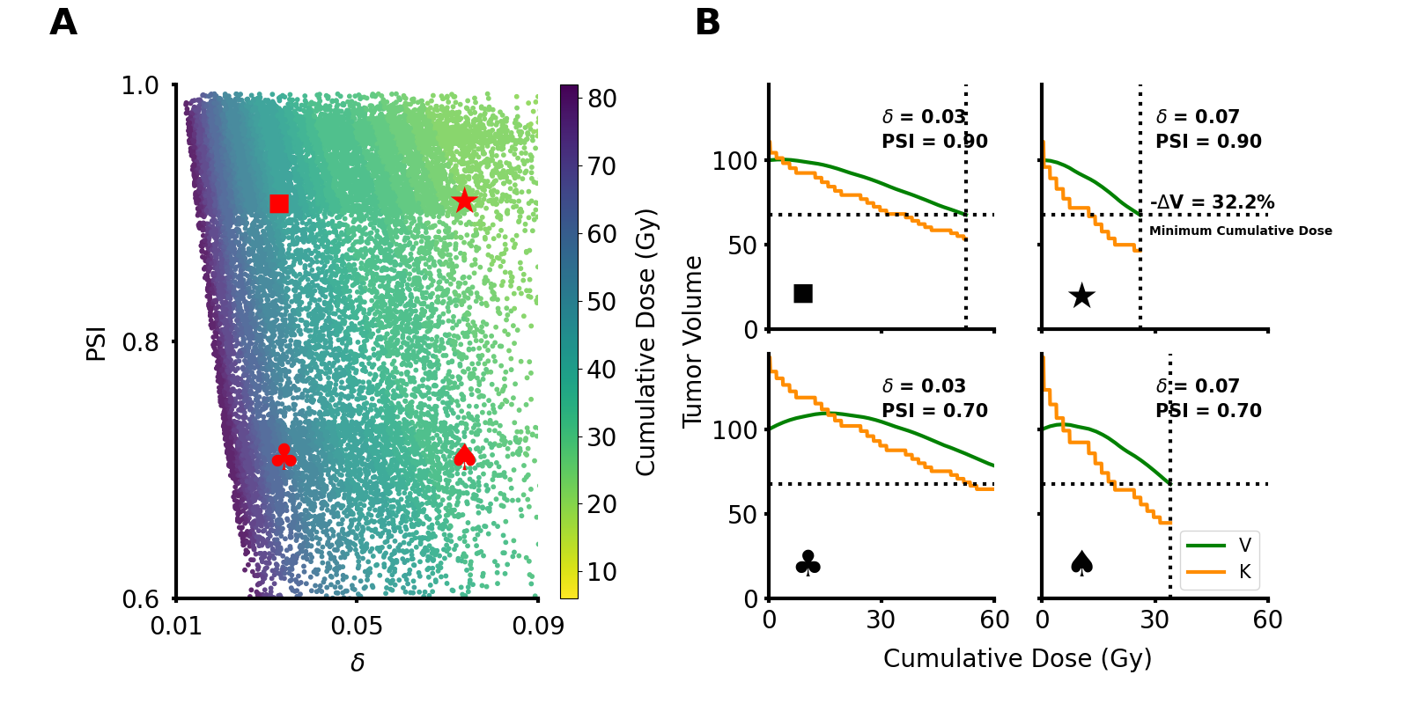



Slide 7
